Slide 1
Object-Oriented JavaScript

Slide 2
Objects
Objects represent real world things - anything, really.
They maintain that thing’s state and behavior

Slide 3
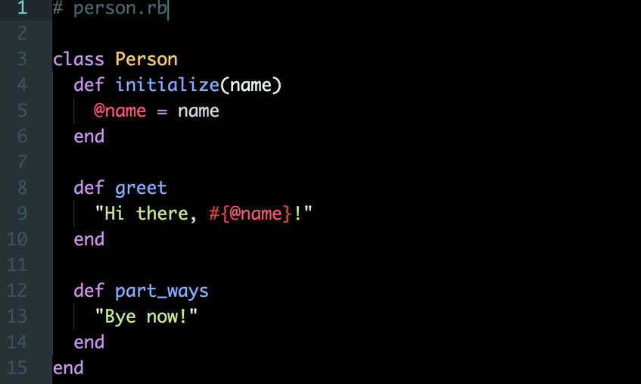
In Ruby...

Slide 4
In Ruby...
State is a characteristic or attribute of the object
Typically represented by instance variables

Slide 5
In Ruby...
Behavior constitutes actions that the object is able to perform
In Ruby, these are methods

Slide 6
JavaScript Objects
are containers for named values.
- W3School

Slide 7
They look a lot like Ruby’s Hash objects

Slide 8
Here is a JavaScript Object..
let myCat = {
name: ‘Lina’,
size: ‘small’,
fuzzy: true,
happy: true,
tummyRub: function() { this.happy = false },
headRub: function() { this.happy = true },
}

Slide 9
Here is a JavaScript Object..
let myCat = {
name: ‘Lina’,
size: ‘small’,
fuzzy: true,
happy: true,
tummyRub: function() { this.happy = false },
headRub: function() { this.happy = true }
}
State - primitive data types representing properties

Slide 10
Here is a JavaScript Object...
let myCat = {
name: ‘Lina’,
size: ‘small’,
fuzzy: true,
happy: true,
tummyRub: function() { this.happy = false },
headRub: function() { this.happy = true }
}
Behavior - functions that do something. In this case, they modify the state of the object

Slide 11
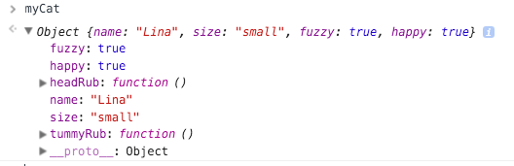
Here is what that object will look like in your console...
let myCat = {
name: ‘Lina’,
size: ‘small’,
fuzzy: true,
happy: true,
tummyRub: function() { this.happy = false },
headRub: function() { this.happy = true }
}

Slide 12
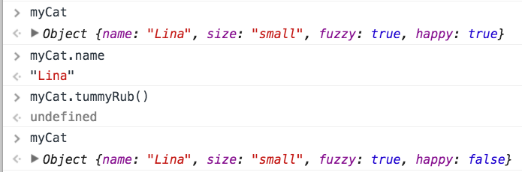
Accessing object properties
Access properties using the dot operator

Slide 13
Changing object properties using methods
Access properties using the dot operator
Similar to how methods might change instance variables in Ruby

Slide 14
Let’s focus on how to create objects

Slide 15
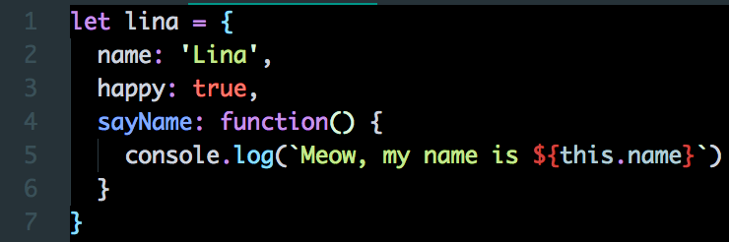
Object Literal
let myCat = {
name: ‘Lina’,
happy: true
}
Similar to creating a Ruby Hash by..
my_cat = { name: ‘Lina’, happy: true }

Slide 16
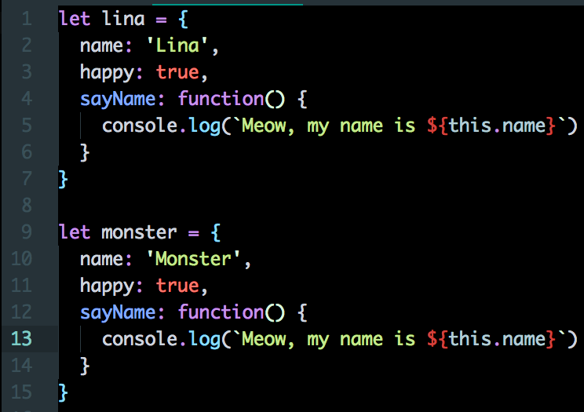
Object Literal
What you see is what you get. Every time there’s a new cat, you need to create a new object literal.

Slide 17
What is `this`?
this refers to the object that is calling the method

Slide 18
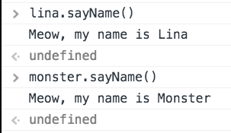
What is `this`?
this refers to the object that is calling the method

Slide 19
But what if we want to create multiple, similar objects?

Slide 20
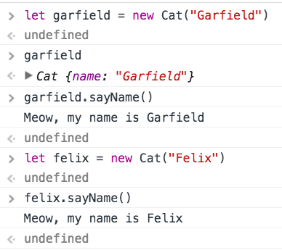
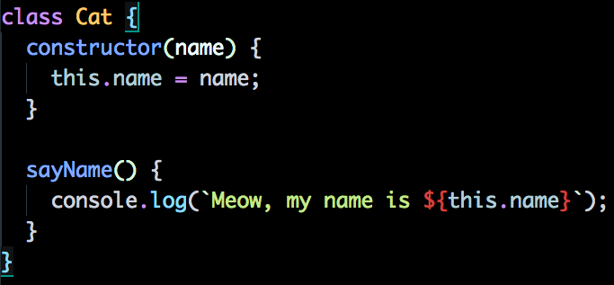
Using ES6 Classes*

Slide 21
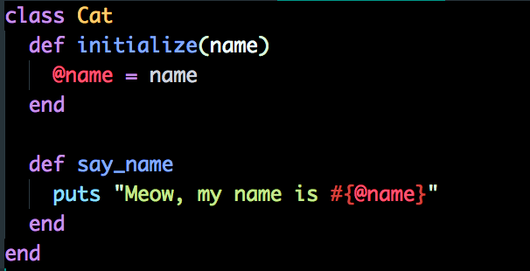
Similar to Ruby classes*

Slide 22
Recap
Not everything in JS is an object, but many things are. They represent real-world “things”
JS objects are containers of named value pairs
Just like Ruby, they maintain state and behavior
They look similar to Ruby’s Hash data type
ES6 Classes provide a syntax for creating objects that mimics Ruby-style OOP

Slide 23
Thanks!
Any questions ?
You can find me at
@justinhuynh

